Slide 1
CSE 486/586 Distributed Systems Consensus --- 1
Steve Ko
Computer Sciences and Engineering
University at Buffalo

Slide 2
Recap: Reliable and Ordered Multicast
How do a group of processes communicate?
R-Multicast
Properties: integrity, agreement, validity
Ordering
FIFO
Total
Causal
Ordered multicast algorithms
FIFO order: maintains a per-process clock similar to a vector clock
Total order: sequencer-assigned, ISIS (sender-assigned)
Causal order: uses a vector clock

Slide 3

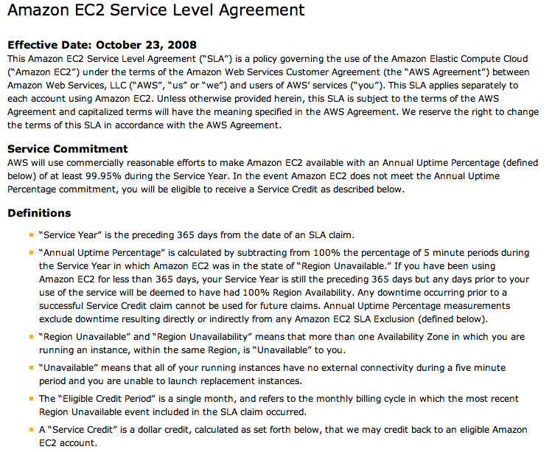
Let’s Consider This…

Slide 4
One Reason: Impossibility of Consensus
Q: should Steve give an A to everybody taking CSE 486/586?
Input: everyone says either yes/no.
Output: an agreement of yes or no.
Bad news
Asynchronous systems cannot guarantee that they will reach consensus even with one faulty process.
Many consensus problems
Reliable, totally-ordered multicast (what we saw already)
Mutual exclusion, leader election, etc. (what we will see)
Cannot reach consensus.

Slide 5
The Consensus Problem
N processes
Each process p has
input variable x_{p} : initially either 0 or 1
output variable y_{p} : initially b (b=undecided) – can be changed only once
Consensus problem: design a protocol so that either
all non-faulty processes set their output variables to 0
Or all non-faulty processes set their output variables to 1
There is at least one initial state that leads to each outcomes 1 and 2 above

Slide 6
Assumptions (System Model)
Processes fail only by crash-stopping
Synchronous system: bounds on
Message delays
Max time for each process step
e.g., multiprocessor (common clock across processors)
Asynchronous system: no such bounds
E.g., the Internet

Slide 7
First: Synchronous Systems
Every process starts with an initial input value (0 or 1).
Every process keeps the history of values received so far.
The protocol proceeds in rounds.
At each round, everyone multicasts the history of values.
After all the rounds are done, pick the minimum.

Slide 8
First: Synchronous Systems
For a system with at most f processes crashing, the algorithm proceeds in f+1 rounds (with timeout), using basic multicast (B-multicast).
Values^{r}_{i}: the set of proposed values known to process p=P_{i} at the beginning of round r.
Initially Values⁰_{i} = {} ; Values¹_{i} = {v_{i}=x_{p}}
for round r = 1 to f+1 do
multicast (Values^{r}_{i})
Values ^{r+1}_{i} ← Values^{r}_{i}
for each V_{j} received
Values ^{r+1}_{i} = Values^{r+1}_{i} ∪ V_{j}
end
end
y_{p}=d_{i} = minimum(Values^{f+1}_{i})

Slide 9
Why Does It Work?
Assume that two non-faulty processes differ in their final set of values → proof by contradiction
Suppose p_{i} and p_{j} are these processes.
Assume that p_{i} possesses a value v that p_{j} does not possess.
Intuition: p_{j} must have consistently missed v in all rounds. Let’s backtrack this.
→ In the last round, some third process, p_{k}, sent v to p_{i}, and crashed before sending v to p_{j}.
→ Any process sending v in the penultimate round must have crashed; otherwise, both p_{k} and p_{j} should have received v.
→ Proceeding in this way, we infer at least one crash in each of the preceding rounds.
→ But we have assumed at most f crashes can occur and there are f+1 rounds ==> contradiction.

Slide 10
CSE 486/586 Administrivia
You can use Amazon EC2 for project 1.
Details will be covered in the recitations next week.
You will need to
Create an account on Amazon AWS.
Create an instance using the CSE 486/586 image.
Download & install NX client (a free remote desktop client), and use it to connect to your instance
The image has
Eclipse
Android SDK
Two scripts: one creating multiple instances, the other setting up redirections
Amazon has graciously provided a grant.

Slide 11
Second: Asynchronous Systems
Messages have arbitrary delay, processes arbitrarily slow
Impossible to achieve consensus
even a single failed is enough to avoid the system from reaching agreement!
a slow process indistinguishable from a crashed process
Impossibility applies to any protocol that claims to solve consensus
Proved in a now-famous result by Fischer, Lynch and Patterson, 1983 (FLP)
Stopped many distributed system designers dead in their tracks
A lot of claims of “reliability” vanished overnight

Slide 12
Are We Doomed?
Asynchronous systems cannot guarantee that they will reach consensus even with one faulty process.
Key word: “guarantee”
Does not mean that processes can never reach a consensus if one is faulty
Allows room for reaching agreement with some probability greater than zero
In practice many systems reach consensus.
How to get around this?
Two key things in the result: one faulty process & arbitrary delay

Slide 13
Techniques to Overcome Impossibility
Technique 1: masking faults (crash-stop)
For example, use persistent storage and keep local checkpoints
Then upon a failure, restart the process and recover from the last checkpoint.
This masks fault, but may introduce arbitrary delays.
Technique 2: using failure detectors
For example, if a process is slow, mark it as a failed process.
Then actually kill it somehow, or discard all the messages from that point on (fail-silent)
This effectively turns an asynchronous system into a synchronous system
Failure detectors might not be 100% accurate and requires a long timeout value to be reasonably accurate.

Slide 14
Recall
Each process p has a state
program counter, registers, stack, local variables
input register xp : initially either 0 or 1
output register yp : initially b (b=undecided)
Consensus Problem: design a protocol so that either
all non-faulty processes set their output variables to 0
Or non-faulty all processes set their output variables to 1
(No trivial solutions allowed)

Slide 15
Proof of Impossibility: Reminder
State machine
Forget real time, everything is in steps & state transitions.
Equally applicable to a single process as well as distributed processes
A state (S1) is reachable from another state (S0) if there is a sequence of events from S0 to S1.
There an initial state with an initial set of input values.

Slide 16
p
p’
send(p’,m)
receive(p’)
may return null
Global Message Buffer
“Network”

Slide 17
Different Definition of “State”
State of a process
Configuration: = Global state. Collection of states, one per process; and state of the global buffer
Each Event consists atomically of three sub-steps:
receipt of a message by a process (say p), and
processing of message, and
sending out of all necessary messages by p (into the global message buffer)
Note: this event is different from the Lamport events
Schedule: sequence of events

Slide 18
C
Configuration C
C
Event e’=(p’,m’)
C’
Schedule s=(e’,e’’)
C’’
Event e’’=(p’’,m’’)
C’’
Equivalent

Slide 19
Lemma 1
Schedules are commutative
C
Schedule s2
Schedule s1
s1 and s2
can each be applied
to C
involve
disjoint sets of
receiving processes
C’
s2
s1
C’’

Slide 20
Summary
Consensus: reaching an agreement
Possible in synchronous systems
Asynchronous systems cannot guarantee.
Asynchronous systems cannot guarantee that they will reach consensus even with one faulty process.
Next: continue on consensus

Slide 21
Acknowledgements
These slides contain material developed and copyrighted by Indranil Gupta (UIUC).

